Slide 1
Shipment Temperatures for Data Analysis
Valeryia Lupanava

Slide 2
prerequisites
Initial requirements are provided in the file home_assignment_-_senior_data_engineer.pdf.
Requestor is Data Analyst team.

Slide 3
Questions and answers

Slide 4
The expected result is to provide the Data Analysts team with a complete data infrastructure for them to connect their visualization tool to - how would you collaborate with them to gather requirements?
Analysis phase:
Reading requirements and checking, accesses to required systems, and analyzing source data (if possible);
Identifying a set of questions to clarify before implementing design;
Identifying stakeholders for answering business and technical questions – Product Owner, Team Leader, etc.;
Setting up and holding a meeting with stakeholders to:
determine ownership and responsibility;
clarify all questions, which key parties have, important for design and implementation;
identify communication channels and set up a schedule for status calls;
establish deadlines.

Slide 5
Design phase:
Preparing Data Flow design considering provided inputs;
Consulting design with Architects/Team Lead (if any);
Preparing POC on a limited amount of data to test the design;
Presenting achieved results internally to Architects/Team Lead (if any);
Presenting DF and POC to stakeholders to clarify additional questions if any;
Preparing/refining a set of PBIs to achieve the goal.
To this moment all key questions must be answered to unblock development.
Moving to the next phases – Implementation, Testing, and Release.
For ongoing communication and status checks agreed in the Analysis phase communication channels must be used.

Slide 6
What design approach you would use to build the data model, and why?
I would choose Kimball’s Star Data Model with dimensions and facts.
And then three DM: conceptual (ER model), logical, and physical, - should be built and each after each agreement must be achieved.
In provided DM I see a customer as a dimension, logger_temperature as a transactional fact table, and shipments as accumulating fact table. A new table with required aggregations would be a periodic snapshot with daily information.
This DM includes fewer entities and allows fewer joins, thus should be faster and more convenient to use.

Slide 7
What design approach you would use to build and orchestrate the data flow, and why?
For orchestration, I would use DataBricks Workflows.
This service is part of DataBricks resource, so no additional resource maintenance would be required.
This service allows the creation of jobs with multiple tasks and setting up dependencies.
Triggers can be easily set up for a job, e.g. schedule.
Source code can stored in GitHub or Workspace.

Slide 8
Assuming an infrastructure where these two datasets are accessible in Databricks. Using a framework or language suitable for Databricks (e.g. SQL or pyspark), create the desired dataset for the analysts to use.
This chapter is explained in the Solution part.

Slide 9
What changes would we need to make to allow for multiple loggers in a shipment?
The Data Model should be changed to include shipment_id foreign key in Shipments fact table which would allow the identification of a specific shipment. And, consequently, a dimension with shipment details should be a part of DM.
In the provided Data Model if we have multiple loggers per shipment, it will be not clear how to aggregate data and determine whether loggers X, Y, and Z are from shipment W or not.
If the assumption is that one customer per shipment, it would work then, but only in case there is one shipment per customer at a given timeframe.

Slide 10
SOlution

Slide 11
Assumptions
Several logger_ids per one shipment. One shipment is identified by customer_id.
Min and Max temperatures are calculated per shipment, per status.
Start and end dates indicated start and end of shipment status.
The logger receives information every hour for the past hour.
For POC purposes data is generated for all objects in Databricks Warehouse (DBR WH), except final dataset shipments_analysis.
It is enough to calculate shipments_analysis once a day for the previous day.

Slide 12
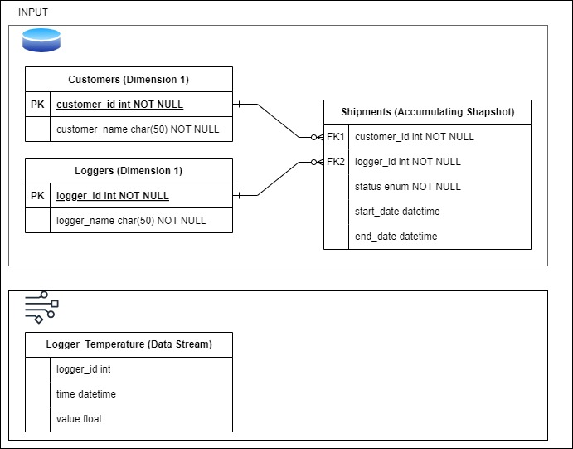
SOURCE Data Model. Database and Data stream

Slide 13
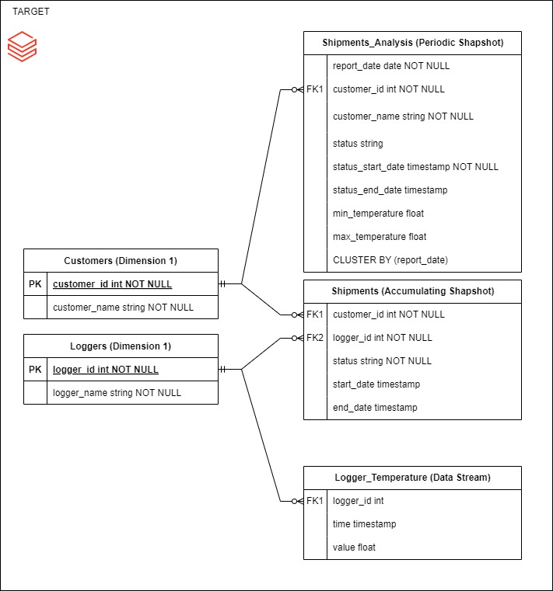
Target Data Model in databricks warehouse
Output dataset is shipments_analysis.

Slide 14
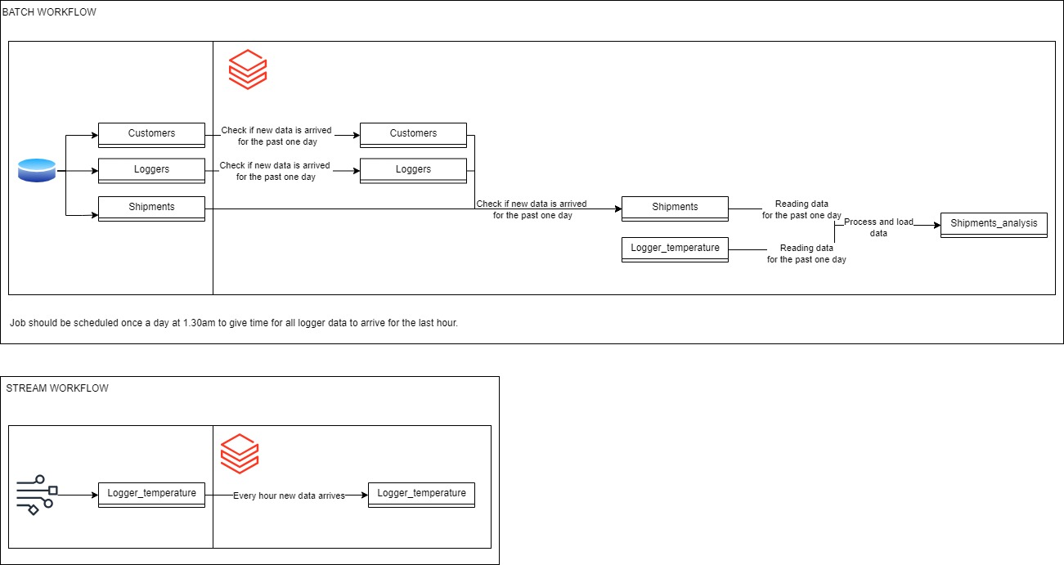
Data Flow
All existing tables are replicated into DBR Warehouse in incremental mode before the final dataset shipments_analysis is calculated.
Shipments_analysis is calculated for the previous day once a day.
Data Stream is loaded into DBR Warehouse logger_temperature table with a streaming workflow.

Slide 15
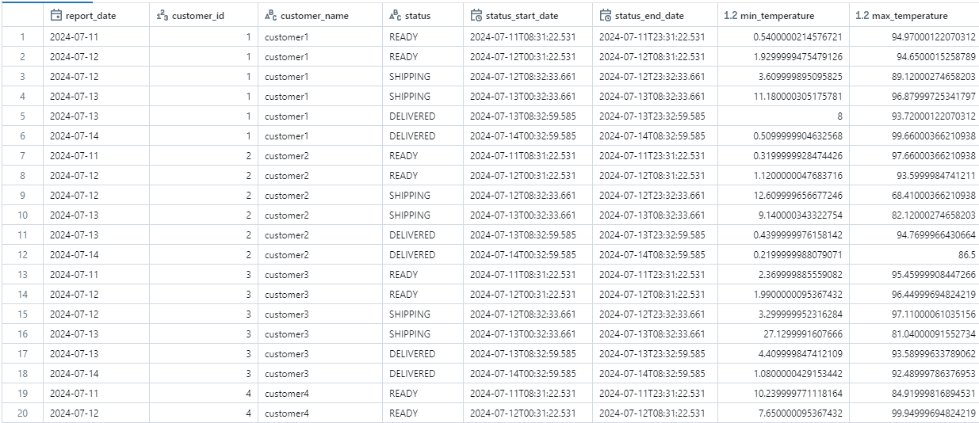
Data in Output dataset (Example)

Slide 16
Files
DDL for creating delta-tables - https://github.com/ValeryiaLupanava/shipment-assignment/blob/main/shipments_ddl.sql
DML for populating delta-tables - https://github.com/ValeryiaLupanava/shipment-assignment/blob/main/shipments_dml.sql
Final notebook with shipments_analysis calculation - https://github.com/ValeryiaLupanava/shipment-assignment/blob/main/shipment_analysis.py
Diagrams are drawn in Drawio - https://github.com/ValeryiaLupanava/shipment-assignment/tree/main/diagrams

Slide 17
Thank you!
Valeryia Lupanava
valeria.lupanava@gmail.com

